Slide 2



INTRODUCTION
What is software testing?
It is the process used to identify the correctness, completeness and quality of developed computer software.
It is the process of executing a program/application under positive and negative conditions by manual or automated means. It checks for the :-
Specification
Functionality
Performance

Slide 3

Error, Bug, Fault & Failure
Error : It is a human action that produces the incorrect result that produces a fault.
Bug : The presence of error at the time of execution of the software.
Fault : State of software caused by an error.
Failure : Deviation of the software from its expected result. It is an event.

Slide 4
SDLC(Software Development Life Cycle)
Standard model used word wide to develop a software.
A framework that describes the activities performed at each stage of a software development project.
Necessary to ensure the quality of the software.
Logical steps taken to develop a software product.

Slide 5

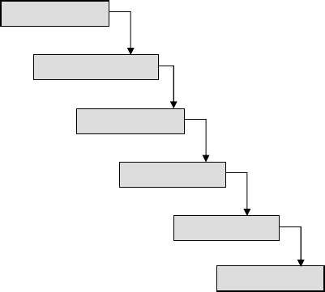
Classical Waterfall Model
Feasibility Study
Requirements Analysis & Specification
Design
Coding & Unit Testing
Integration & System Testing
Maintenance
It is the oldest and most widely used model in the field of software development.

Slide 6
Testing Life Cycle
Project Initiation
Summary Reports
System Study
Analysis
Test Plan
Regression Test
Design Test Cases
Report Defects
Execute Test Cases ( manual /automated )

Slide 7

Test Plan
It is a systematic approach to test a syst i.e. software.
The plan typically contains a detailed understanding of what the eventual testing workflow will be.

Slide 8

Test Case
It is a specific procedure of testing a particular requirement.
It will include:
Identification of specific requirement tested Test case success/failure criteria
Specific steps to execute test
Test data

Slide 9
Verification vs Validation
Verification: The software should confirm to its specification (Are we building the product right?)
Validation: The software should do what the user really requires (Are we building the right product?)

Slide 10

1. Black box testing
2. White box testing

Slide 11
Black box testing
Is a method of software testing that examines the functionality of an application without peering into its internal structures or workings.
This method of test can be applied virtually to every level of software testing: unit, integration, system and acceptance.
Is a software testing method in which the internal structure/design/implementation of the item being tested is not known to the tester.
These tests can be functional or non-functional, though usually functional.

Slide 12




Black box testing
requirements
output
input
events

Slide 13
White box testing
The testing of a software solution's internal structure, design, and coding. In this type of testing, the code is visible to the tester.
It focuses primarily on verifying the flow of inputs and outputs through the application, improving design and usability, strengthening security.
White box testing is also known as Clear Box testing,

Slide 14



White box testing
Test data
Tests
Derives
Component code
Test outputs

Slide 15
Testing Levels
Unit testing
Integration testing
System testing

Slide 16
UNIT TESTING
Is a level of software testing where individual units/ components of a software are tested.
The purpose is to validate that each unit of the software performs as designed.
A unit is the smallest testable part of any software.
It usually has one or a few inputs and usually a single output.

Slide 17

INTEGRATION TESTING
Once all the modules have been unit tested, integration testing is performed.
It is systematic testing.
Produce tests to identify errors associated with interfacing.
Types:
Big Bang Integration testing Top Down Integration testing Bottom Up Integration testing Mixed Integration testing

Slide 18
Big Bang Integration testing: an integration testing strategy wherein all units are linked at once, resulting in a complete system.
Top-Down Integration Testing: an integration testing technique used in order to simulate the behaviour of the lower-level modules that are not yet integrated.
Bottom Up Integration: Each component at lower hierarchy is tested individually and then the components that rely upon these components are tested
Integration testing tests integration or interfaces between components, interactions to different parts of the system such as an operating system, file system and hardware or interfaces between systems.

Slide 19


SYSTEM TESTING
The system as a whole is tested to uncover requirement errors.
Verifies that all system elements work properly and that overall system function and performance has been achieved.
Types:
Alpha Testing Beta Testing
Acceptance Testing Performance Testing

Slide 20
Alpha Testing
It is carried out by the test team within the developing organization .
Beta Testing
It is performed by a selected group of friendly customers.
Acceptance Testing
It is performed by the customer to determine whether to accept or reject the delivery of the system.
Performance Testing
It is carried out to check whether the system meets the nonfunctional requirements identified in the SRS document.

Slide 21
Types of Performance Testing:
Stress Testing Volume Testing Configuration Testing Compatibility Testing Regression Testing Recovery Testing Maintenance Testing
Documentation Testing Usability Testing

